Slide 1

CUSTOMER RETENTION PROJECT
A case study from Indian
e-commerce customers
JASMINE KAUR
FLIP ROBO TECHNOLOGIES
DATA SCIENCE INTERN
INTERNSHIP 18

Slide 2

A Secret Ingredient To
Retain The Customers

Slide 3

PROBLEM STATEMENT
Customer retention is one of the important keys in any business. It is directly correlated with the customer satisfaction.
There is need to investigate about the factors that influence the online customers repeat purchase intention.
The combination of both utilitarian value and hedonistic values are needed to affect the repeat purchase intention (loyalty) positively

Slide 4
UNDERSTANDING THE PROBLEM
One of the most important factor of the success of an e-commerce business is Customer Satisfaction.
It has been posited as a key stimulant of purchase, repurchase intentions and customer loyalty.
Five major factors that contributed to the success of an e-commerce store have been identified as:
service quality
system quality
information quality
trust
net benefit

Slide 5
BUSINESS GOAL
To analyse the data collected from the Indian online shoppers.
To bring out the insights from the data which is very critical to understand the factors that influence customer satisfaction.
This will lead to success of the e-retail business.

Slide 6
DATASET INFORMATION
The dataset has 269 rows and 71 columns
There is no null value in the data
There is presence of outliers and skewness in the data
Some of the features are of object data type while others are numerical

Slide 7

EXPLORATORY DATA ANALYSIS

Slide 8

ANALYSIS WITH THE PERSONAL INFORMATION DATA

Slide 9
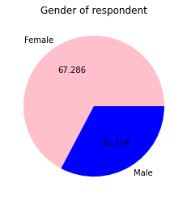
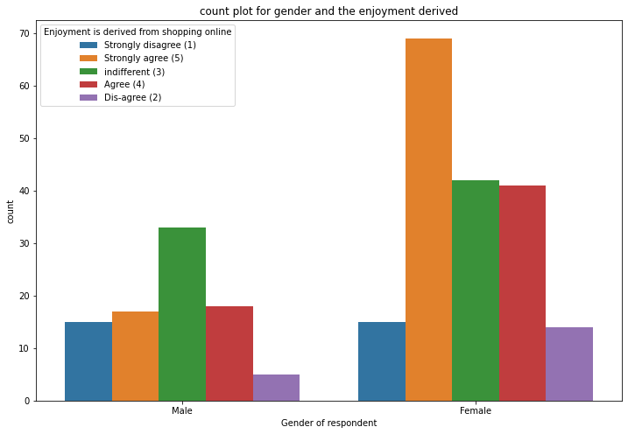
GENDER
female respondents are twice in number as compared to the male respondents
On an average, females enjoy more while doing online shopping as compared to males.

Slide 10
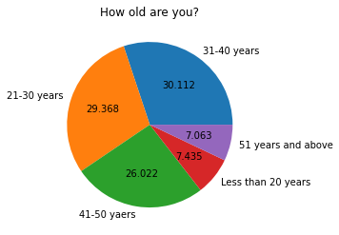
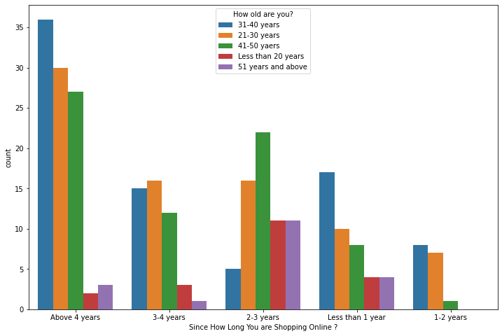
AGE
Most of the respondents are in the age group 31-40 years.
This is followed by the age group 21-30 years.
the third highest number of respondents are in the age group 41-50 years.
This is then followed by teenagers and then the senior citizens.
Highest number of people who have been shopping online lies between the age group 20-50 years.
The graph represents that the highest number of teenagers and senior citizen are shopping online from 2-3 years.
There are no teenagers and senior citizens who are shopping online from 1-2 years in the survey data.

Slide 11
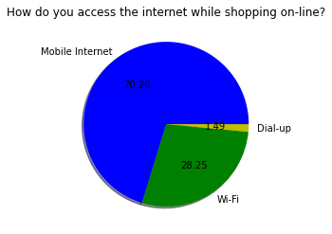
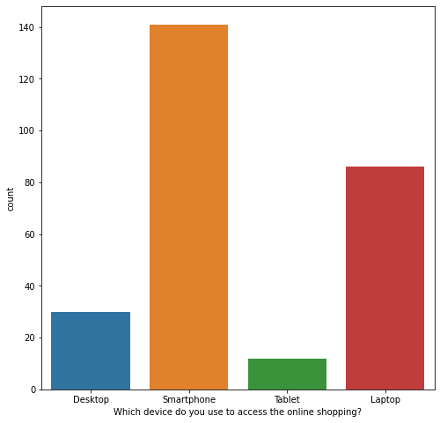
INTERNET AND DEVICE USAGE
Around 70% of the respondents use mobile internet for making an online purchase.
This is followed by Wi-Fi which constitutes 28.25% of the total respondents.
Only a negligible percent i.e. 1.48% of people dial up to do online shopping
The highest number of people use Smartphone
for doing online shopping.
The second highest used device is laptop.
Some people use Desktop to make online purchases.
Vey few of them use tablet to do online shopping.

Slide 12
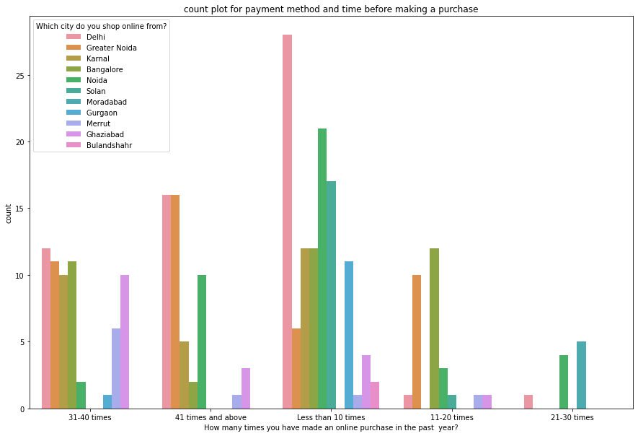
CITY OF THE RESPONDENTS
Most of the people have purchased less than 10 times in the past year.
Mostly, those who purchased between 11 to 20 times, stay in Noida or greater Noida.
Very few people purchased 21-30 times, those who purchase stay in Delhi, Noida or Gurgaon.
Those who purchased 31-40 times are generally from Delhi, Greater Noida, Karnal, Bangalore, and Ghaziabad.
Most people who purchased more than 41 times are either from Delhi or Greater Noida. Also, some of them are from Bangalore or Karnal or Merrut or Bulandshahr.

Slide 13
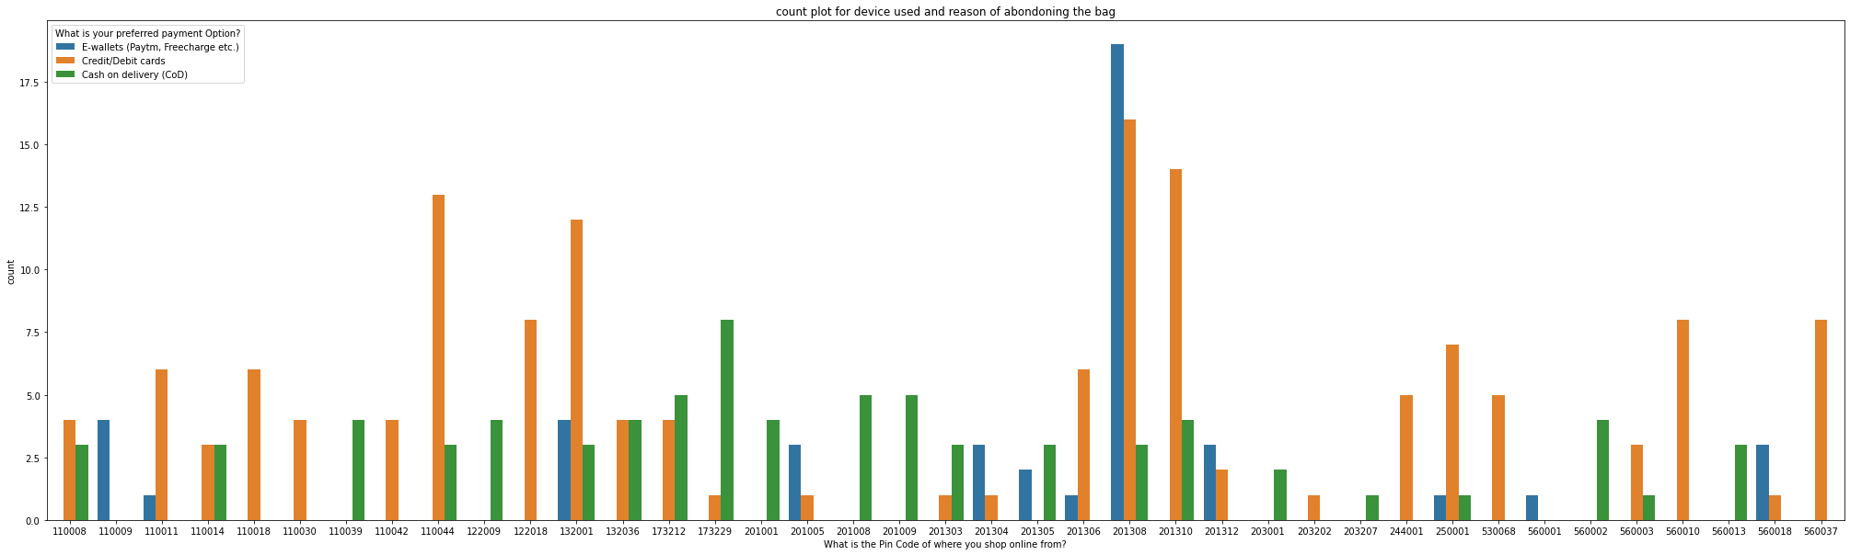
PINCODE OF THE RESPONDENTS
Comparatively less people use E-wallets and there are many pin codes that do not use E-wallets at all.
The only pin code where the maximum number of people uses E-wallets is 201308.
Most of the people use Credit/Debit cards. The people who do not use Credit/Debit cards are from the pin code: 201008, 201009,201305, 203207, 560001, 560002,56013. The people in pin code 201308 and 201310 are those who use the Credit/Debit cards the most.
There are few pin codes that do not use the cash on delivery payment option at all. While relatively less people prefer using COD in other pin codes.

Slide 14

ANALYSIS ABOUT THE REPEAT PURCHASE BEHAVIOUR OF THE CUSTOMER

Slide 15
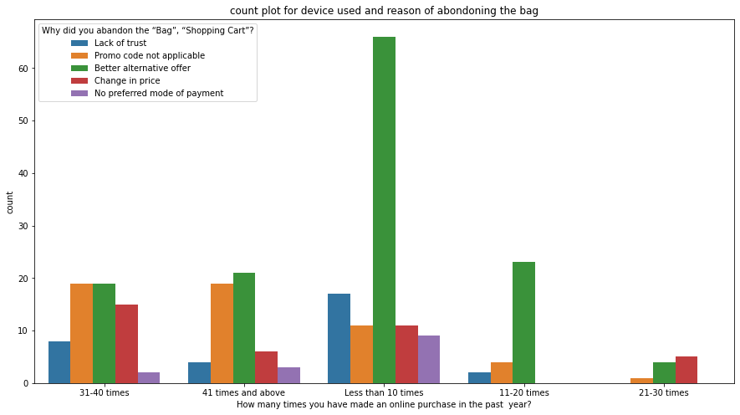
DEVICE USED AND THE REASON FOR ABANDONING THE BAG/CART
Those who purchased less than 10 times in the past year, mostly abandoned their bags because they were able to see some better alternative offer. In this category other reasons for abandoning is quite less as compared to the better alternative offer.
Those who purchased 11-20 times, abandoned their bags because of the better alternative offer. Negligible percentage of people abandoned due to Lack of trust and promo code not applicable. There is no other reason fro abandoning bags who purchased 11-20 times.
Those who purchased 21-30 times, abandoned their bags the least. Still, those who did, the reasons include promo code not applicable, better alternative offer, change in price.
Those who purchase 31 times to 40 times and 41 times and above have almost the same distribution for the reasons of abandoning the bag. It is just those who made 31-40 purchases, abandoned their bags more than those who made more than 41 purchases due to the lack of trust and change in price.

Slide 16
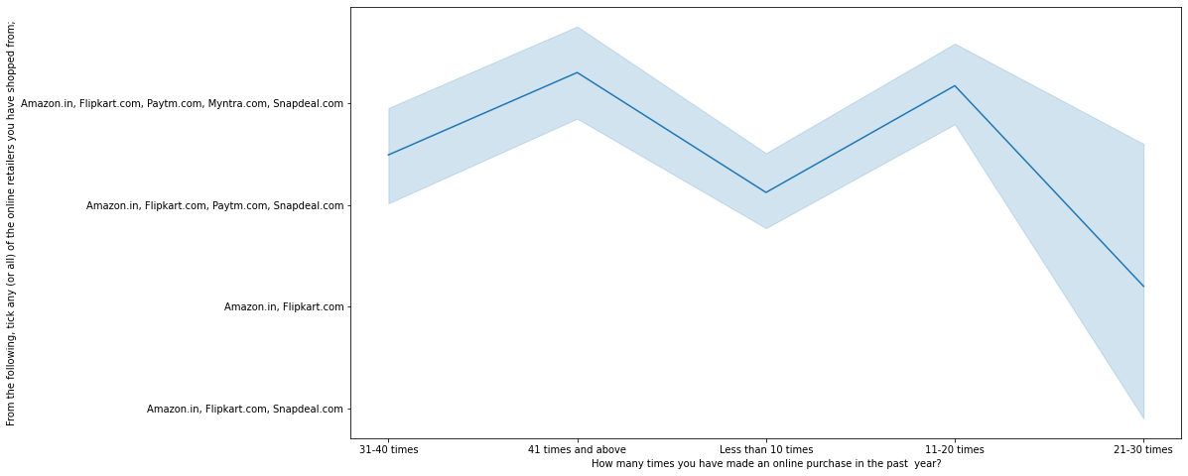
Online retailers respondents hAve shopped from in the past year
Common online store that all the respondents have made purchase from is Amazon.com and Flipkart.com
Those who made 31-40 purchases or less than 10 purchases have not used Myntra
Those who purchased 21-30 times, exclude Myntra.com and snapdeal.com

Slide 17
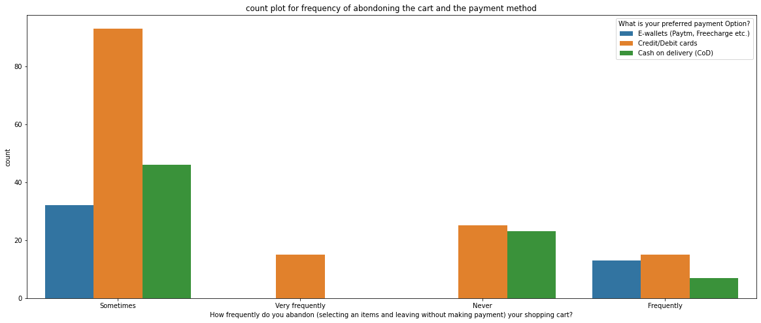
Frequency of abandoning the cart and the payment method
Those who abandon their bags very frequently have Credit/Debit cards as their preferred payment option.
Those who abandon their carts frequently choose all sorts of payment option. The least used option in this category is cash on delivery.
Those who sometimes abandon their carts mostly prefer Credit/Debit Cards, followed by COD and the least used method of payment is E-wallets.
Those who never abandon their carts, prefer either Credit/Debit Cards or COD.

Slide 18
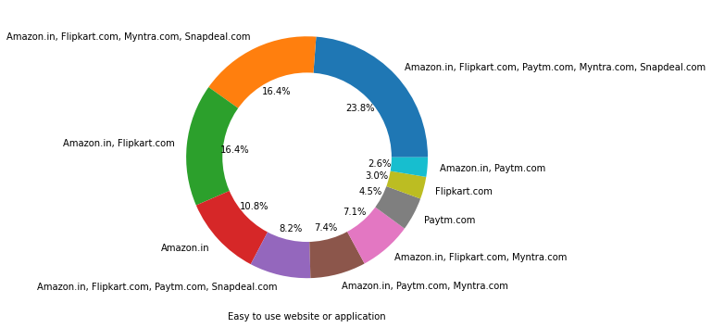
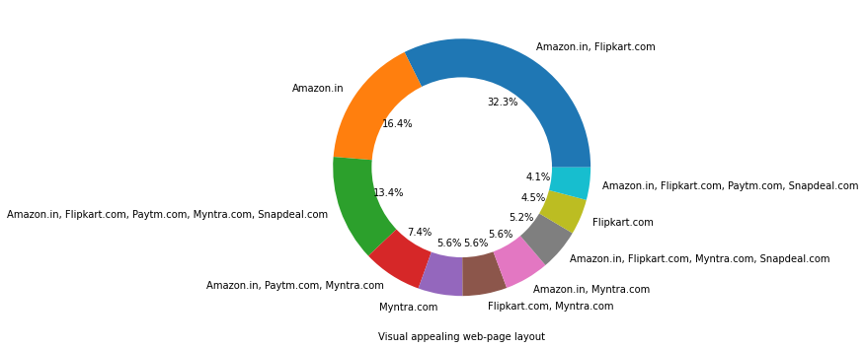
Website features
EASY TO USE WEBSITE
VISUAL APPEALING WEB-PAGE LAYOUT

Slide 19
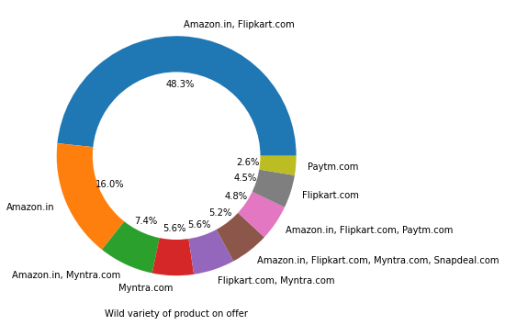
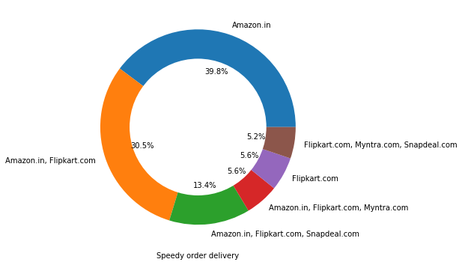
OFFERS AND DELIVERY
WIDE VARIETY OF PRODUCTS ON OFFER
SPEEDY DELIVERY

Slide 20

ANALYSIS ON THE BASIS OF UNSATISFACTORY SERVICE

Slide 21
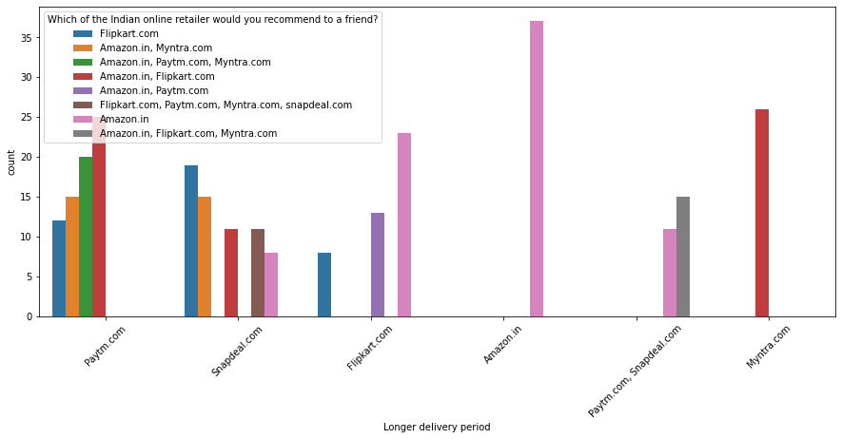
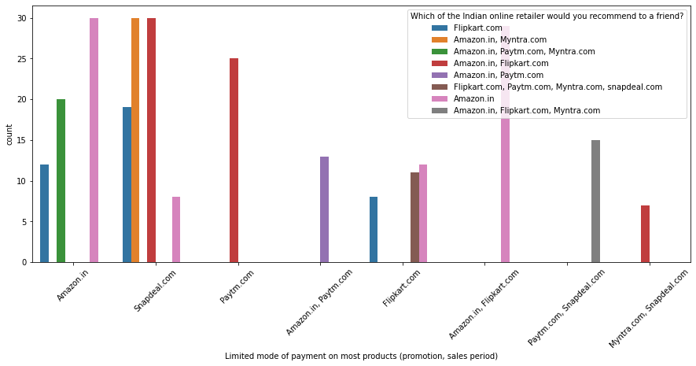
Delay in delivery and less payment methods
LONGER DELIVERY TIME
LIMITED MODE OF PAYMENTS

Slide 22
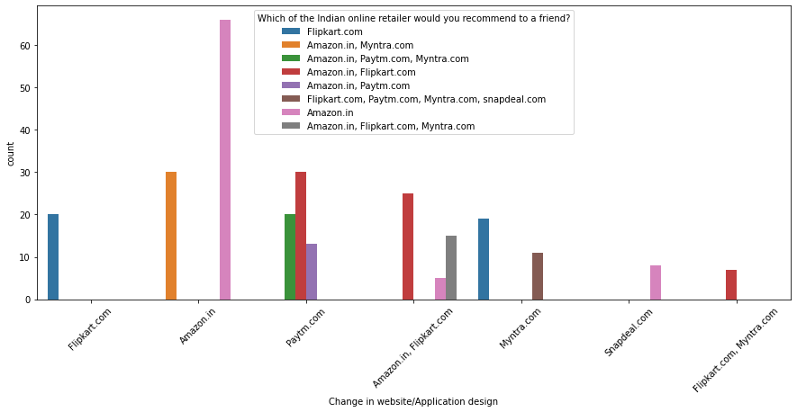
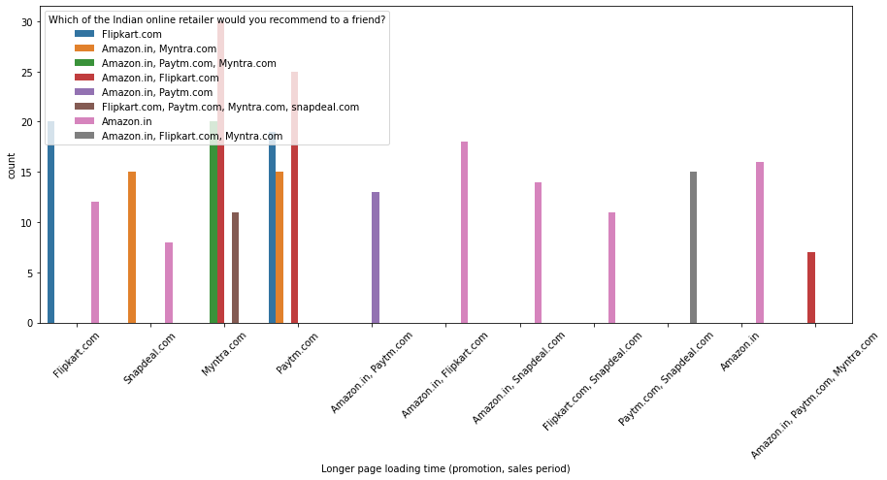
DESIGN AND LOADING TIME
CHANGE IN WEBSITE DESIGN
LONGER PAGE LOADING TIME

Slide 23
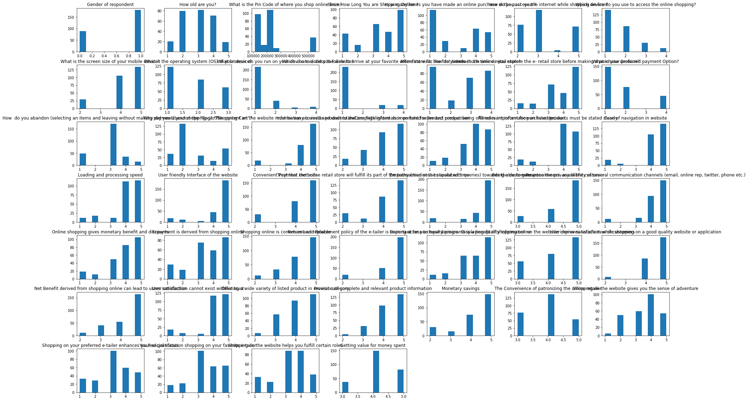
The distribution of the variables:

Slide 24
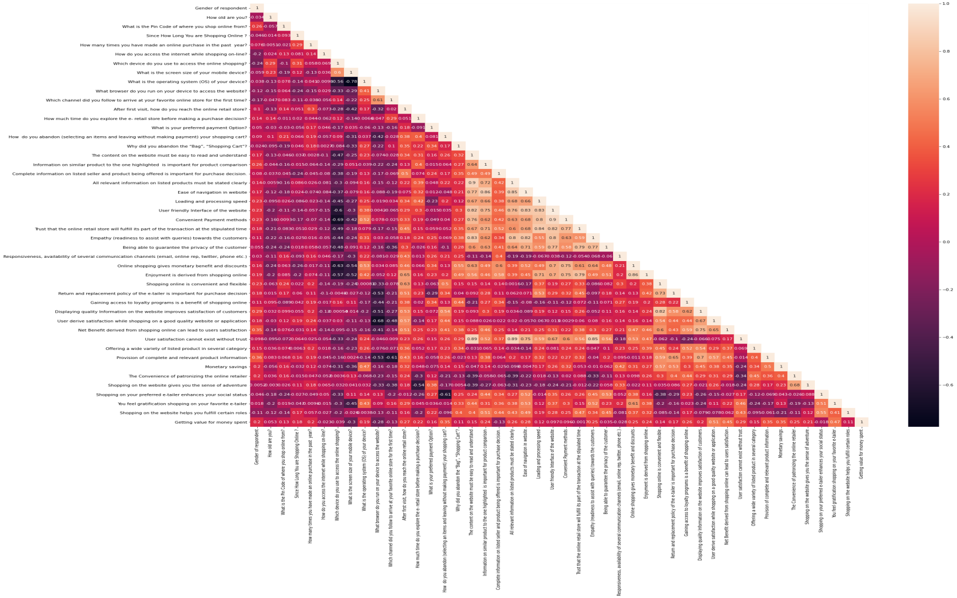
Heatmap of the dataset

Slide 25
STEPS USED IN THE PROJECT
Define the Problem
Data Exploration and Visualization Using:
Pandas (data analysis)
Numpy (matrix computation)
Matplotlib.pyplot (Visualization)
Seaborn (visualization)
Warnings (filter warnings) & etc.
Microsoft Excel ( for calculations and Data Handling)

Slide 26
ASSUMPTIONS AND TOOLS USED
Assumed that Mobile Internet and Mobile internet are the same feature, so combined the both.
Combined 41 times and above with 42 times and above in the how many times you shopped last year.
Hardware and Software Requirements:-
Hardware:4GB RAM, 64Bit O/S.
Software Tools: Python 3, Google Colaboratory, MS-Excel, Notepad.

Slide 27
CONCLUSION
The findings from the project can help e-commerce websites to extent their business:
The costing of products, reliability and brand of the company along with the return policies play an important role in buying and retention behavior of the customers.
The online platform gives the customer the benefit of comparing the prices, thus being competitive in the market allows the firm to stay and make good number of sales otherwise the customers may switch to the other websites.
The trust on the website is very important as the stores are not present physically and the customers don’t know the sellers personally, so in order to influence to customer to purchase from their website, it is very important to have a bridge of trust between the two parties.

Slide 28
CONCLUSION(CONT.)
In online shopping, customer purchases the goods on the basis of a photograph. The photograph can misleading or different from the expectation of the customers. If the return policy is very rigid, the customer will hesitate to buy, no matter how much that person likes the product. Thus, it is important to have flexible return policies.
The payment method determines the purchase behavior. Some customers prefer cash on delivery while other prefers digital payment. The availability of both the methods caters a wider range of customer.
Last, but not the least, the quality of the product and service must be up to the mark in order to make the buyer a permanent customer.

Slide 29
Trend according to the data available:
Some websites are preferred more than the others. Amazon is the most preferred website, which is followed by the Flipkart.
These two companies are most trusted and are thus realiable.
Snapdeal and PayTM have more sellers from tier 2 and tier 3 cities while Amazon and Flipkart have more sellers from Tier 1 cities.
The top companies have most lenient return policies and they take less time to process a return

